Slide 1
Chapter: Structure

Slide 2
What is structure?
Structure is a user-defined data type in C which allows you to combine different data types to store a particular type of record.
Structure helps to construct a complex data type in more meaningful way. It is somewhat similar to an Array.
The only difference is that array is used to store collection of similar datatypes while structure can store collection of any type of data.
Structure is used to represent a record.
Suppose you want to store record of Student which consists of student name, address, roll number and age. You can define a structure to hold this information.

Slide 3
Structure Definition
Keyword struct is used for creating a structure.
Syntax of structure :
We can create the structure for a person as mentioned :
struct structure_name
{
data_type member1;
data_type member2;
.
.
data_type memeber;
};
struct person
{
char name[50];
int no;
float salary;
};

Slide 4
Structure Variable Declaration
When a structure is defined, it creates a user-defined type but, no storage or memory is allocated.
For the structure of a person, variable can be declared as:
struct person
{
char name[50];
int citNo;
float salary;
};
int main()
{
struct person person1, person2;
return 0;
}

Slide 5
Structure Variable Declaration
Another way of creating a structure variable is:
struct person
{
char name[50];
int citNo;
float salary;
} person1, person2;
In both cases, two variables person1, person2 of type struct person are created.

Slide 6
Accessing members of a structure
Members of structures i.e. variables declared in a structure can be assessed using period or member access operator(.)
Any member of a structure can be accessed as:
structure_variable_name.member_name
Suppose, we want to access salary for variable person2. Then, it can be accessed as:
person2.salary

Slide 7
Using typedef while using structure
Writing struct structure_name variable_name; to declare a structure variable isn't intuitive as to what it signifies, and takes some considerable amount of development time.
So, use typedef to name the structure as a whole. For example:
typedef struct complex
{
int imag;
float real;
} comp;
int main()
{
comp comp1, comp2;
}
Here, typedef keyword is used in creating a type comp (which is of type as struct complex).
Then, two structure variables comp1 and comp2 are created by this comp type.

Slide 8
Structure initialization
Like any other data type, structure variable can also be initialized at compile time.
struct Person
{
float height;
int weight;
int age;
};
struct Person p1 = { 180.75 , 73, 23 }; //initialization
or
struct Person p1;
p1.height = 180.75; //initialization of each member separately
p1.weight = 73;
p1.age = 23;
You can copy an entire structure to another structure by just equating. i.e. p2 = p1, this will copy all the values in p1 to p2.

Slide 9
Structure initialization
One more way of initializing can be :
struct Person
{
float height;
int weight;
int age;
} p1 = { 180.75 , 73, 23 };
struct student
{
int mark1;
int mark2;
int mark3;
} sub1={67};
Though, there are three members of structure, only one is initialized , Then remaining two members are initialized with Zero (default value).
int will take 0, float/double will take 0.000000 and char will take NULL.

Slide 10
Size of Structure
Different ways of calculating size of structure
By observation
By using sizeof() Operator
WAY 1 : Calculate by adding Individual Sizes
Size = size of 'Pages' + size of 'Name' + size of 'Author' + size of 'Price'
= 4 + 10 * 1 + 10 * 1 + 4
= 4 + 10 + 10 + 4
= 28
struct Book
{
int pages;
char name[10];
char author[10];
float price;
}b1;

Slide 11
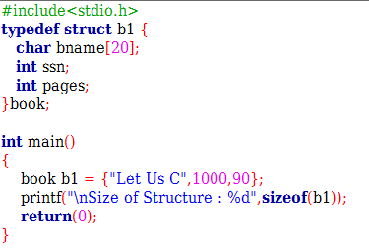
Size of Structure
WAY 2 : Calculate by using sizeof() operator

Slide 12
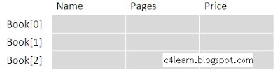
Array of structures
Structure is used to store the information of One particular object but if we need to store such 100 objects then Array of Structure is used.
struct Bookinfo
{
char bname[20];
int pages;
int price;
}Book[100];
Here Book structure is used to Store the information of one Book.
In case, if we need to store the Information of 100 books then Array of Structure is used.
b1[0] stores the Information of 1st Book , b1[1] stores the information of 2nd Book and so on. We can store the information of 100 books.

Slide 13
Nested Structures
Structure written inside another structure is called as nesting of two structures.
We can write one Structure inside another structure as member of another structure.
WAY 1 : Declare two separate structures
Structure members are accessed using dot operator.
‘date‘ structure is nested within Employee Structure.
Members of the ‘date‘ can be accessed using ’employee’
emp1 & doj are two structure names (Variables)
Accessing Month Field : emp1.doj.month
Accessing day Field : emp1.doj.day
Accessing year Field : emp1.doj.year
struct date
{
int date;
int month;
int year;
};
struct Employee
{
char ename[20];
int ssn;
float salary;
struct date doj;
} emp1;

Slide 14
Nested Structures
WAY 2 : Declare embedded structures
Structure members are accessed using dot operator.
‘date‘ structure is nested within Employee Structure.
Members of the ‘date‘ can be accessed using ’employee’
emp1 & doj are two structure names (Variables)
Accessing Month Field : emp1.doj.month
Accessing day Field : emp1.doj.day
Accessing year Field : emp1.doj.year
struct Employee
{
char ename[20];
int ssn;
float salary;
struct date
{
int date;
int month;
int year;
}doj;
}emp1;

Slide 15
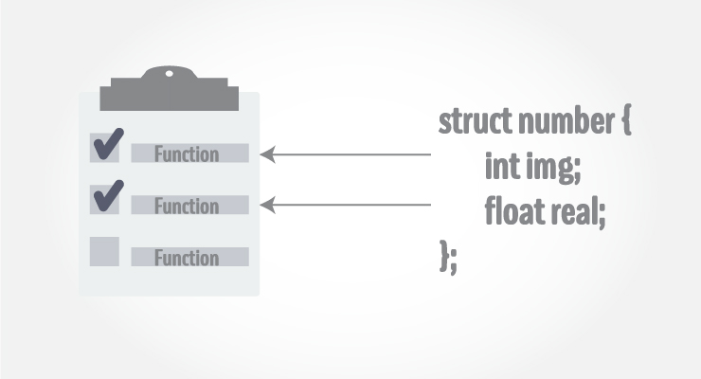
Passing structure to function
There are mainly two ways to pass structures to a function:
Passing by value
Passing by reference

Slide 16
Passing structure by value
A structure variable can be passed to the function as an argument as a normal variable.
If structure is passed by value, changes made to the structure variable inside the function definition does not reflect in the originally passed structure variable.
Function prototype should be below to the structure declaration otherwise compiler shows error.

Slide 17
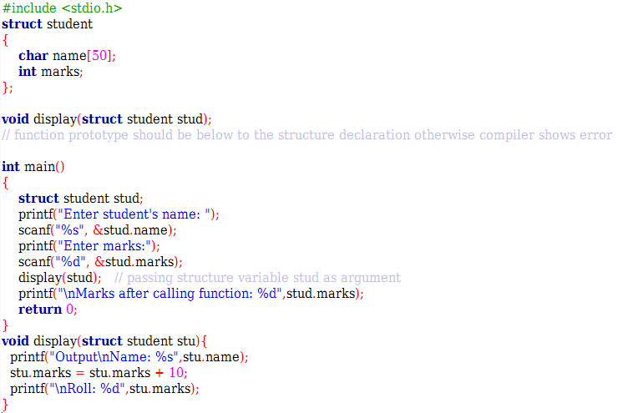
Passing structure by value

Slide 18
Passing structure by reference
The memory address of a structure variable is passed to function while passing it by reference.
If structure is passed by reference, changes made to the structure variable inside function definition reflects in the originally passed structure variable.
Use the same concept of passing an address and receiving it in pointer variable in the called function.

Slide 19
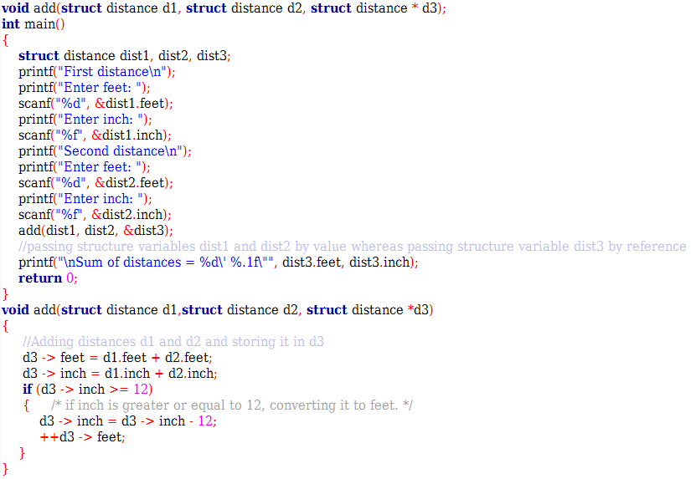
Passing structure by reference

Slide 20
Passing structure by reference
In this program, structure variables dist1 and dist2 are passed by value to the add function (because value of dist1 and dist2 does not need to be displayed in main function).
But, dist3 is passed by reference ,i.e, address of dist3 (&dist3) is passed as an argument.
Due to this, the structure pointer variable d3 inside the add function points to the address of dist3 from the calling main function. So, any change made to the d3 variable is seen in dist3 variable in main function.
As a result, the correct sum is displayed in the output.

Slide 21
Structure and Pointer
Structures can be created and accessed using pointers. A pointer variable of a structure can be created as below:
struct name {
member1;
member2;
.
.
};
int main()
{
struct name *ptr;
}
Here, the pointer variable of type struct name is created.

Slide 22
Accessing structure's member through pointer
Can be accessed by referencing pointer to another address to access memory.
Using -> operator (Membership Operator) to access structure pointer member
Structure pointer member can also be accessed using -> operator.
(*personPtr).age is same as personPtr->age
(*personPtr).weight is same as personPtr->weight

Slide 23
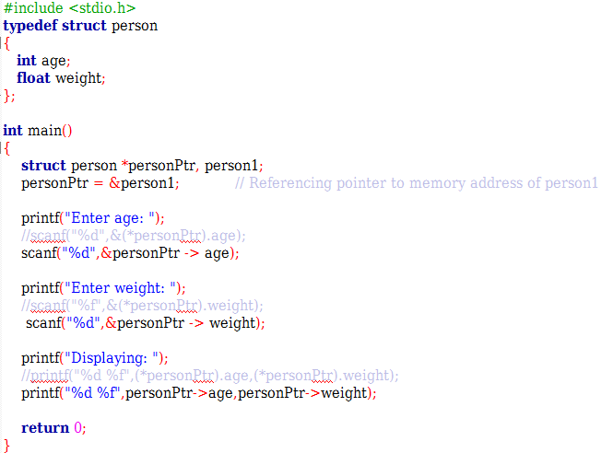
Accessing structure's member through pointer

Slide 24
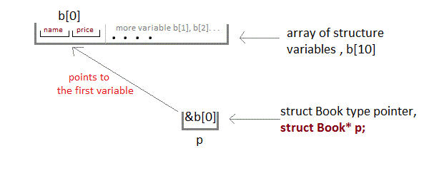
Pointer to array of structures
struct Book
{
char name[10];
int price;
}
int main()
{
struct Book a; //Single structure variable
struct Book* ptr; //Pointer of Structure type
ptr = &a;
struct Book b[10]; //Array of structure variables
struct Book* p; //Pointer of Structure type
p = &b;
}

Slide 25
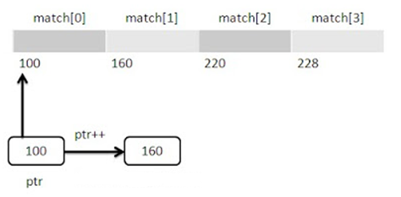
Pointer to array of structures
struct Cricket
{
char team1[20];
char team2[20];
char ground[18];
int result;
}match[4] = {
{"IND","AUS","PUNE",1},
{"IND","PAK","NAGPUR",1},
{"IND","NZ","MUMBAI",0},
{"IND","SA","DELHI",1}
};
int main()
{
struct Cricket *ptr = match;
return 0;
}

Slide 26
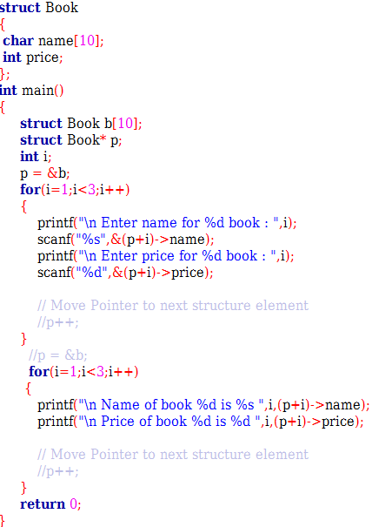
Pointer to array of structures

Slide 27
Function returning structure
Refer the following programs:
returning_structure.c

Slide 28
Union
Structures allocate enough space to store all their members, whereas unions can only hold one member value at a time.
union car
{
char name[50];
int price;
}
;
int main() {
union car car1, car2, *car3;
return 0; }

Slide 29
Thank you!!!

